Slide 1
基于Docker的高性能并行异构系统设计
开题报告 范欣 11.2017

Slide 2
Agenda
Docker Overview
Docker hub
Docker usage
CUDA
Demo

Slide 3
Docker Overview
Basic
Docker is the world’s leading software container platform. Developers use Docker to eliminate “works on my machine” problems when collaborating on code with co-workers. Operators use Docker to run and manage apps side-by-side in isolated containers to get better compute density. Enterprises use Docker to build agile software delivery pipelines to ship new features faster, more securely and with confidence for both Linux and Windows Server apps.
Using containers, everything required to make a piece of software run is packaged into isolated containers. Unlike VMs, containers do not bundle a full operating system - only libraries and settings required to make the software work are needed. This makes for efficient, lightweight, self-contained systems and guarantees that software will always run the same, regardless of where it’s deployed.
Website: https://www.docker.com/
What is a Container
A container image is a lightweight, stand-alone, executable package of a piece of software that includes everything needed to run it: code, runtime, system tools, system libraries, settings. Available for both Linux and Windows based apps, containerized software will always run the same, regardless of the environment. Containers isolate software from its surroundings, for example differences between development and staging environments and help reduce conflicts between teams running different software on the same infrastructure.

Slide 4
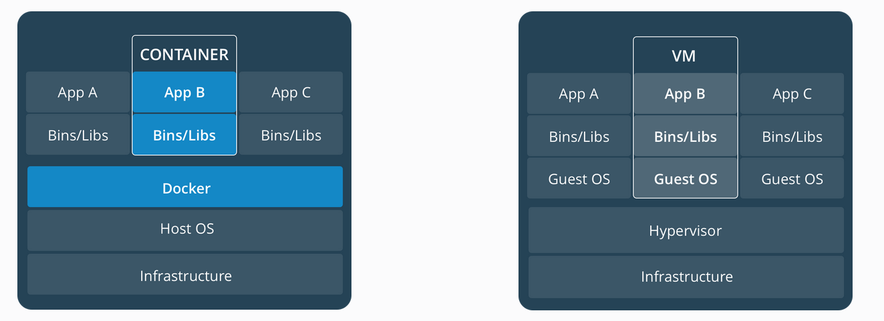
DOCKER Overview
Comparing Containers and Virtual Machines
Containers
Containers are an abstraction at the app layer that packages code and dependencies together. Multiple containers can run on the same machine and share the OS kernel with other containers, each running as isolated processes in user space. Containers take up less space than VMs (container images are typically tens of MBs in size), and start almost instantly.
Virtual Machines
Virtual machines (VMs) are an abstraction of physical hardware turning one server into many servers. The hypervisor allows multiple VMs to run on a single machine. Each VM includes a full copy of an operating system, one or more apps, necessary binaries and libraries - taking up tens of GBs. VMs can also be slow to boot.

Slide 5
Docker hub
Basic
Docker Hub is a cloud-based registry service which allows you to link to code repositories, build your images and test them, stores manually pushed images, and links to Docker Cloud so you can deploy images to your hosts. It provides a centralized resource for container image discovery, distribution and change management, user and team collaboration, and workflow automation throughout the development pipeline.
Key features of Docker hub
Image Repositories: Find and pull images from community and official libraries, and manage, push to, and pull from private image libraries to which you have access.
Automated Builds: Automatically create new images when you make changes to a source code repository.
Webhooks: A feature of Automated Builds, Webhooks let you trigger actions after a successful push to a repository.
Organizations: Create work groups to manage access to image repositories.
GitHub and Bitbucket Integration: Add the Hub and your Docker Images to your current workflows.

Slide 6
Docker usage (local)
Install Docker
https://docs.docker.com/engine/installation/linux/docker-ce/ubuntu/
Configure your Docker environment (Ubuntu 14.04)
sudo service docker stop
sudo vi /etc/default/docker
Edit DOCKER_OPTS
(DOCKER_OPTS="--dns 10.19.185.252 --dns 10.19.185.253 --bip=192.168.0.1/16 --fixed-cidr=192.168.1.0/24)
sudo service docker start

Slide 7
Docker usage (repository)
Pull/Push images from repository
Login docker repository (docker login)
default is connected to docker hub
docker search (Search the Docker Hub for images)
Manage images (docker image <command>)
pull (Pull an image or a repository from a registry)
push (Push an image or a repository to a registry)

Slide 8
CUDA:3 Ways to Accelerate Applications
Applications
Libraries
OpenACC
Programming Languages
Easiest Approach
Maximum Performance
Notes:
一般来说，开发者可以通过三种方式来进行进行GPU软件开发。
我们可以利用一些现成的函数库，这些库可能是NVIDIA开发的，也可能是第三方开发的，通常都经过相应的测试和应用。使用这些函数库，可以帮助你在开发过程中节省大量的时间和精力。
但是并非我们所有的需求都有对应的函数库，而相对的，我们希望对代码进行很小的改动就能达到在GPU进行加速的效果。这种情况下，我们可以使用基于OpenACC的编译指导。OpenACC是开放标准，和OpenMP类似，都是指导性的编译处理方案。我们在需要并行的代码前加上编译指导语言，编译器会自动将该段代码基于GPU进行并行化。
而如果我们对程序性能有很高的要求，希望能最大化地利用GPU的性能，这就需要开发人员利用CUDA直接编写程序。

Slide 9
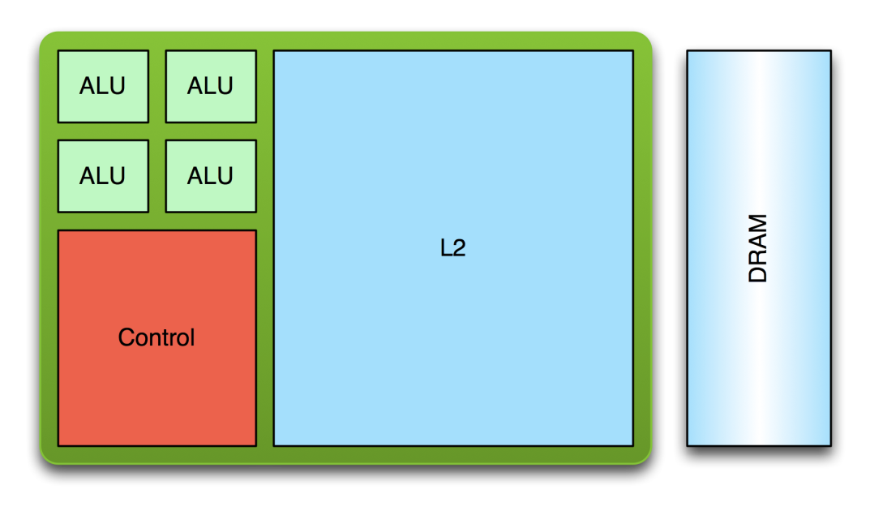
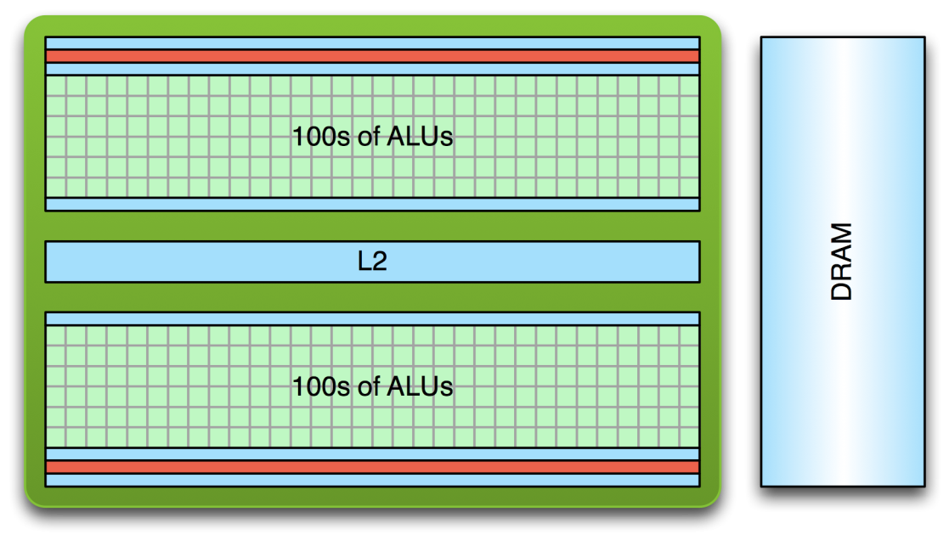
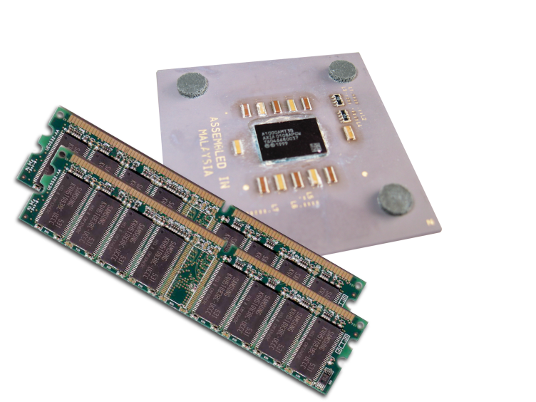
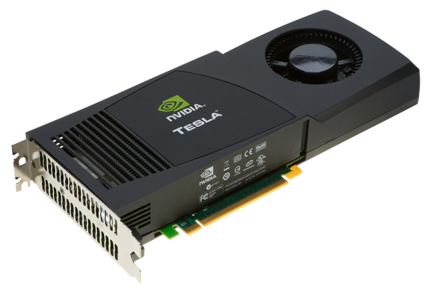
Low Latency or High Throughput
Latency-Optimized
Fast Serial Processing
Throughput-Optimized
Fast Parallel Processing
Notes:
首先我们看一下CPU和GPU的架构有什么不同。
这里，我们给出一个CPU和GPU的架构示意图。
对于CPU，它是一个基于缓存优化的串行处理器，有很大的多级缓存，其设计之初就是着眼于降低内存访问的延迟。而GPU则是针对吞吐优化的并行处理器，和CPU比起来它有更多的计算核心。
同时，CPU把大量的晶体管集中于缓存和控制部分，而GPU将更多的晶体管集中于计算核心。
这样不同的架构，就造成CPU适合于复杂逻辑判断的串行处理，而GPU更适合大规模并行计算。

Slide 10
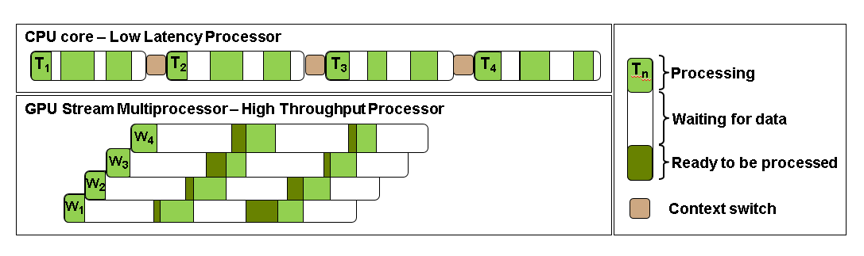
Low Latency or High Throughput
CPU architecture must minimize latency within each thread
GPU architecture hides latency with computation from other thread warps
Notes:
让我们用这张示意图来更进一步理解CPU和GPU的不同。
图中的圆角矩形表示一个线程执行的任务。浅绿色部分是实际进行计算的部分，而白色的部分是等待数据的时间，浅粉色是上下文切换的时间。
我们还是首先看一下CPU的处理过程。在一个CPU核上，每个线程是串行执行的。这里假设一个CPU核串行处理四个任务。在一个线程运行过程中，等待数据时间很小，这是因为CPU的多级缓存和逻辑控制提高了数据的读取速度。另外在线程和线程之间需要进行上下文切换，这也需要耗费一定的时间。总的来说，CPU串行处理四个任务的总时间是各个线程处理时间的总和，再加上额外的上下文切换的开销。
对于GPU来说，同时运行的线程是海量的，而且是轻量级的。单个线程的计算速度同样很快，但是可能需要较长的数据等待时间。同时，还有一些计算核心数据读取后等待被调度的情况。但是海量的线程并行执行，这些延迟就被有效的隐藏了。而总的计算时间相较CPU大大缩短。
这里只是形象的比较了4个任务的情况。如果我们想象有数以千万记的任务并行执行，则GPU的效率将会远远高于CPU。
我们可以看出，如果是计算密集型的，同时有很好并行性的应用程序，GPU可以带来相对于CPU的性能的大幅提高。

Slide 11
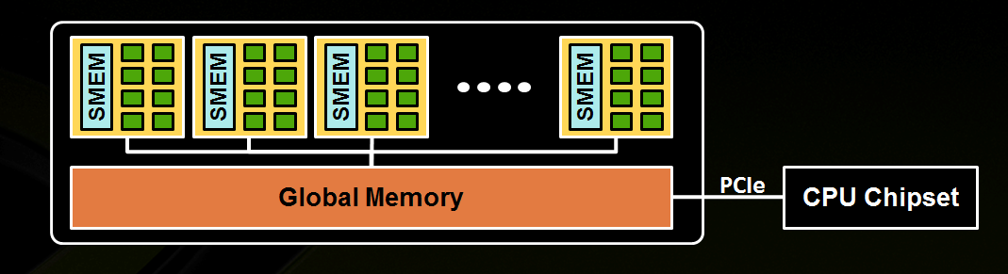
GPU High Level View
Streaming Multiprocessor (SM)
A set of CUDA cores
Global memory
Notes:
为什么GPU能进行这种大规模的并行计算，这和GPU的架构有直接的关系。
我们先看一下GPU架构的简易图。从图中可以看出，GPU在硬件上包括几个关键的模块：计算单元和内存单元。
其中最重要的是流处理器（Streaming Multiprocessor, SM)，实际上GPU就是一个SM阵列，每个SM包含若干cuda计算核心(cores)，以及相应的控制单元和局部的内存单元。
而在这些SM阵列之外，还有一个global memory，也就是我们常说的显存。
下面我们先详细看一下流处理器的结构

Slide 12
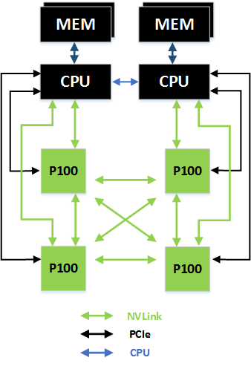
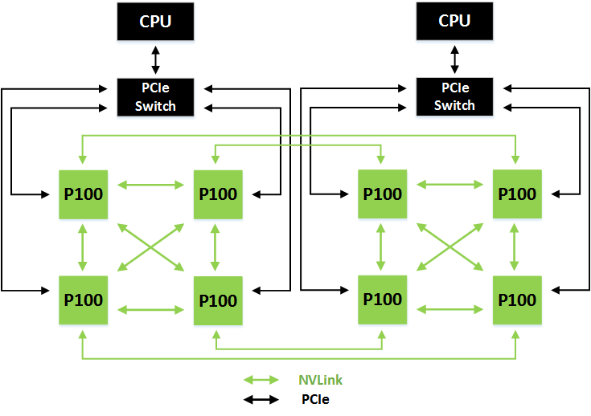
NVLINK – GPU Cluster
160GB/s* per GPU bidirectional to Peers
* 40 GB/s per line X 4 = 160 GB/s
40 GB/s per GPU bidirectional to CPU
Notes:
NVLINK 是英伟达提出的解决方案，通过NVLINK，GPU之间的点对点双向传输速度可以达到40GB/s，每个GPU支持4条Nvlink连接。
如果是使用了NVLink 的CPU，则它和GPU的通过NVLINK点对点双向通信理同样可以达到40GB/s。
这种高速解决方案是高性能计算的一个福音。

Slide 13
Hello World on GPU
CUDA kernel within .cu files
CUDA kernels preceded by “__global__”
CUDA kernels launched with “<<<…,…>>>”
cu files compiled by nvcc
hello_world.cu:
#include <stdio.h>
__global__ void hello_world_kernel( )
{
printf(“Hello World\n”);
}
int main( )
{
hello_world_kernel <<< 1, 1>>>( );
}
Compile &Run:
nvcc hello_world.cu
. / a.out
Notes:
我们把原来的hello world程序稍加更改，就变成了在GPU上运行的hello world程序了。大家可以看到，代码中绿色的部分就是修改添加的部分
我们发现：
文件后缀名标识为.cu，而不是.c文件了
核函数定义时，前面加入了__global__标识符，这个标识符是告诉编译器这是一个在GPU运行的核函数。
调用函数的时候（启动kernel），我们加入了尖括号的标识符，这个尖括号标识符是GPU线程的配置信息，具体的含义，我们后面会讲到。
最后，我们的编译器为nvcc，而不是gcc
大家会发现，其实编写核函数还是很容易理解和上手的。

Slide 14
Demo
Docker(pull, push[login,push],run, images, ps)
OpenMP & OpenACC
Vector add on CUDA
NSIGHT
CUDA-GDB

Slide 15
Appendix
HOW TO UPLOAD YOUR DOCKER IMAGE ONTO DOCKER HUB
1) docker commit <container ID> <repo name>/<Name you want to give the image>
For example= docker commit 99e078826312 chuangg/gene_commited_image
2) docker run -it chaung/gene_commited_image
For example= docker login --userna3) docker login --username=<user username> --password=<user password> me=chuangg --email=gc.genechaung@gmail.com
3) docker push chuangg/gene_commited_image

